Slide 1
Year 4
Geography Curriculum

Slide 2
Whole-school definition of geography
Geography is the study of places and the relationships between people and their environments.

Slide 3
Year 4 Overview
Block 2 | Climate and Weather
Block 4 | Tectonic Plates, Volcanoes and Earthquakes
Block 6 | Waterways of the UK

Slide 4
Block 2
Climate and Weather

Slide 5


Autumn
Why do different areas have different sorts of vegetation?
Key Concept: Climate and Change
Notes:
Change is when something becomes different over time. (adaptation, sustainability)
Climate is the average weather conditions in a place. (climate change, climate zones, pollution, weather)
Change
In geography, we learn about the Earth and how it changes. There are many things around us that change over time, such as landscapes, weather, and the way people use the land.
To better understand change in geography, we can observe and study different things:
e.g.
Maps: Look at different maps of the same area taken at different times. Notice any differences and what might have caused them.
Photographs: Compare old and new photographs of places to see how they have changed over time.
Timelines: Use timelines to track changes and see how things have developed or transformed.
Field Trips: Visit different places and observe the changes in landscapes, weather patterns, or land use.
Climate
Weather and climate are similar but different. Weather changes quickly and can be different from day to day. For example, one day it might be sunny and warm, and the next day it could be raining and cold. Climate, on the other hand, stays the same for longer periods. It tells us what the weather is usually like in a certain place.
To measure climate, scientists look at lots of different things, like temperature, rainfall, and wind patterns. They collect data over many years to get an accurate idea of what the climate is like in a particular place.
Scientists have divided the world into different climate zones. These climate zones help us understand the patterns of weather and climate in different areas. For example, in the United Kingdom, we have a temperate climate zone, which means our weather is usually moderate with rainfall spread throughout the year.

Slide 6
Year 4 Block 2 Climate and Weather | Retrieval vocab: annual, area, atlas, biome, coast, continent, latitude, longitude, North Pole, precipitation, region, South Pole, temperate, thermometer New vocab: desert, evolved, humidity, lichen, moss, polar, rainfall, sedges, sub-tropical, tropical, weather Key concepts: boundaries (continents, locations); cartography (atlases, Equator, latitude, longitude, North/South Pole); change (adaptation); climate (climate zones, weather); interdependence; physical geography (biomes)
Week 1 (retrieval) | Know that geography is the study of places and the relationships between people and their environments Know the names of the seven continents and name on a world map and globe (as a class using a labelled map/globe): Europe, North America, South America, Africa, Asia, Australia and Antarctica. Know the location of the North and South Poles and know that they are the cold parts of the Earth. Know that there are imaginary lines of latitude and longitude on the Earth; know that latitude shows the north/south position of a given location and that longitude shows the east/west position of a given location (see diagram below) Know that the UK does not usually experience extremely cold winters or summers, and is thus a temperate country Know that temperature can be measured using a thermometer Know that particular types of precipitation are more common in different seasons (e.g. snow and ice in winter; rain in the summer)
Week 2 | Understand the terms rainfall, temperature, wind and humidity, and know that weather represents the day-to-day levels of these things and that climate represents an average for a given area Use an understanding of rainfall, temperature, wind and humidity to compare the climates of Chile (specifically the Atacama Desert) and the UK Know that a desert is a region with extremely low precipitation; for example, the world’s largest desert is found in Antarctica – although it is not hot there, there is very little rainfall
Fieldwork - Create a daily chart on the weather in the UK and analyse it at the end of the topic.
Temperature, weather conditions, humidity, wind speed – can look at BBC weather or MET office.
Notes:
Suggested number of sessions on each point to be added

Slide 7
Week 3 | Understand lines of latitude and how the Earth can be divided into polar, temperate, sub-tropical and tropical zones and that each tend to have different climates and biomes; know that a biome is a community of plants and/or animals that share characteristics based on the environment in which they live (e.g. evolved to survive in hot conditions) Use an atlas to locate Greenland, Germany, Portugal and Peru and determine which of the four climate zones these countries are in (polar, temperate, subtropical and tropical respectively) Know that Greenland is part of Denmark, a country in northern Europe; identify Denmark on a map
Week 4
Week 5 | Know that the climate of an area determines the vegetation that will grow their and the animals that will thrive there Know that there are five different types of vegetation region in the world: forest, grassland, tundra, desert, and ice sheet; know that these regions are determined by the climate of an area Know that forest regions are covered in trees; that grasslands are dominated by thick grass; that tundra regions are areas where tree growth is hindered by low temperatures and that a mixture of grass, sedges, lichen and moss dominate; that ice sheet regions are large masses of ice where very little plant-life can survive
Week 6 | Know that when areas of land that are usually dry become covered with water, this is called a flood; floods can be causes by heavy rainfall and storms that lead to temporarily higher sea levels along a coast; floods can lead to destruction of property and even death Know that areas of the UK experience floods and that some areas of the world experience annual floods Know that different maps of the world show the land masses in different ways; this is because it is not possible to accurately represent a 3D curved surface on a 2D plane Recognise the Mercator projection and the fact that it prioritises accurate land mass shapes, but distorts the sizes of land mass, making them look much larger at the poles (Greenland is an excellent example of this as it looks nearly the size of Africa on a Mercator projection, but is actually less than 1/10 the size) (see resource below Recognise the Gall Peters projection and the fact that it prioritises accurate land mass sizes, but distorts the shapes of land masses (see resource below) Recognise the Robinson projection and the fact that it is a compromise between accurate land mass shape and accurate land area where both are inaccurate, but neither in the extreme ways seen in the Mercator projection or the Gall Peters projection (see resource below) Know that that there are various other possible projections and orientations and that the choice of map/orientation (e.g. UK at the centre) is a choice that reveals things about what the map maker and map user prioritise and value Enquiry question: Why do different areas have different sorts of vegetation?

Slide 8
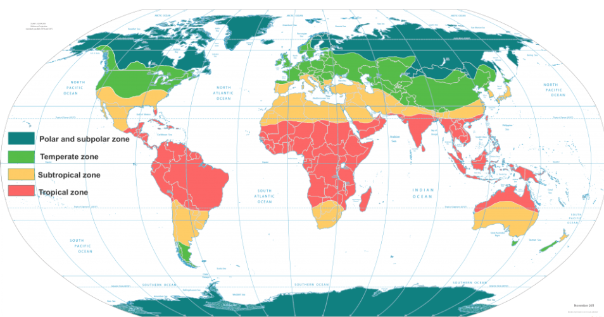

Slide 9
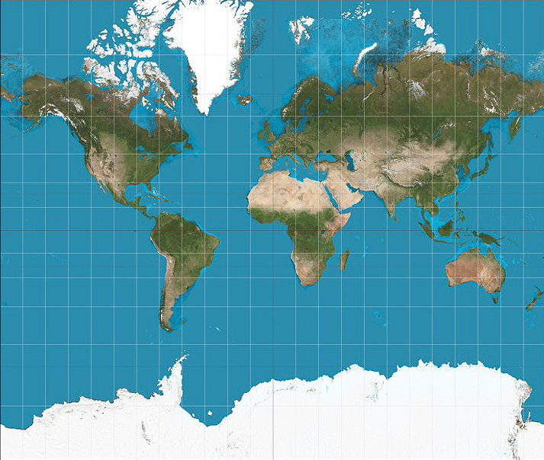
Mercator projection

Slide 10
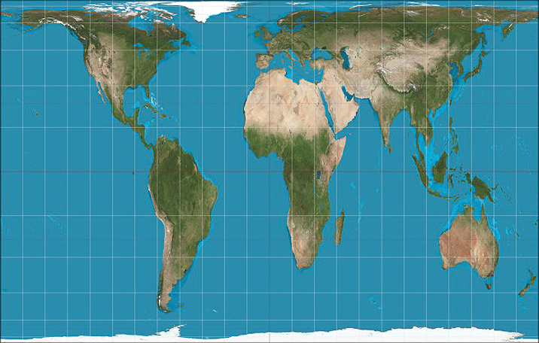
Gall Peters projection

Slide 11
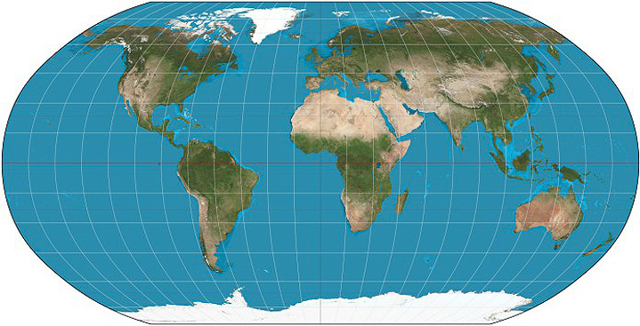
Robinson projection

Slide 12
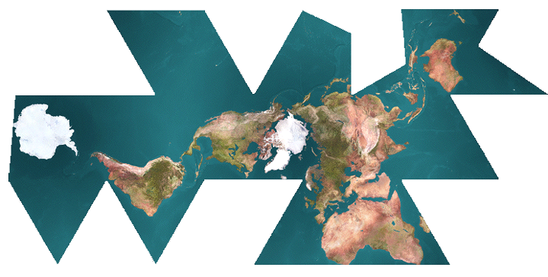
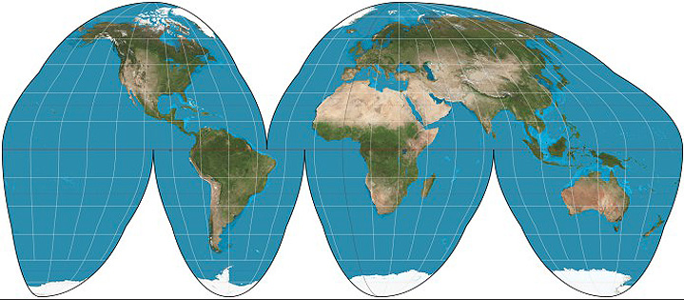
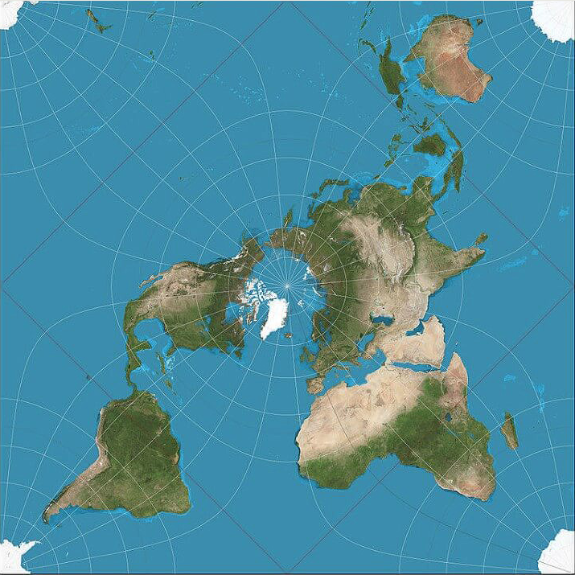
Other projections
(Note that all projections have inherent limitations; also note the fact that showing Earth with a particular country at the centre and with a particular north/south is just a convention.

Slide 13
Block 4
Tectonic Plates, Volcanoes and Earthquakes

Slide 14
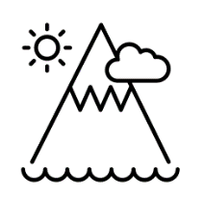

Spring
What impact do volcanoes have on the people who live near them?
Key Concept: Physical Geography and Resources
Notes:
Physical geography is the study of the natural features of the Earth. (biomes, bodies of water, tectonics, topography)
Resources are things that we use or need in our daily lives. They are materials or substances that can be found in nature and can be turned into objects that we use. (energy, food supply, infrastructure)
Physical Features
Physical geography looks at things like landforms, weather, climate, plants, animals, and the different environments around the world.
To study physical geography, we use lots of different methods and tools. Some of these methods include: Maps & globes, fieldwork & observations and satellite images.
Resources
Natural Resources
Natural resources are things that we find in the environment around us. They are not made by people. Some examples of natural resources include:
Water: We need water to drink, wash, and grow our food.
Air: The air we breathe is a natural resource that is essential for life.
Wood: Trees provide us with wood, which we use to build houses and make furniture.
Sunlight: The sun gives us light and heat, which we use for lots of things.
Human-Made Resources
Human-made resources are things that people create or make. They are often made by using natural resources. Some examples of human-made resources include:
Paper: Paper is made from trees, which are a natural resource. We use paper to write, draw, and make books.
Plastic: Plastic is made from things like oil, which is pumped out of the ground. We use plastic for many things, like making toys and containers.
Computers: Computers are made from different materials, including metals and plastic. We use computers to do many activities, such as learning, playing games, and communicating.
Renewable and Non-renewable Resources
Resources can also be divided into two other groups: renewable and non-renewable resources.
Renewable resources are resources that can be replaced or replenished naturally over time. For example, trees can be planted and grown again, so we can use their wood for various purposes. Sunlight is another renewable resource because it will keep shining each day.
Non-renewable resources are resources that cannot be replaced or take a very long time to form. For example, coal and oil are non-renewable resources. Once we use them up, they are gone forever. That's why it's important to use them wisely and find alternative energy sources.

Slide 15
Year 4 Block 4 Tectonic Plates, Volcanoes and Earthquakes | Retrieval vocab: crust, igneous, metamorphic, molten, sedimentary, tectonic plate, volcano, fertile New vocab: active, ash, crater, dormant, earthquake, eruption, fault, flank, iron, lava, magma, mantle, structure, tsunami, upper mantle, vent, volcano Key concepts: physical geography (tectonics); resources (food supply); settlements (population, rural areas)
Week 1 (retrieval from science curriculum) | Know that geography is the study of places and the relationships between people and their environments Know that there are three kinds of rocks: igneous, sedimentary and metamorphic Know that the Earth has a solid crust made up of tectonic plates with molten rock beneath (see diagram below) Know that granite and basalt are types of igneous rock and that igneous rocks form from molten rock below the Earth’s crust Know that marble and slate are types of metamorphic rock which form when rocks in Earth’s crust get squashed and heated in processes such as when tectonic plates press against each other
Week 2 | Know the structure of the Earth - crust, mantle, outer core and inner core (see the diagram below) Know that the crust is a layer of rock on the surface of the Earth Know that the mantle forms about half of the inside of the Earth and is a layer of rock underneath the crust Know that the upper mantle is hard but there is magma (liquid rock) beneath Know that the core is mostly made of iron, which is in the centre of the Earth Know that temperatures at the core can reach 5500ºC Know that the crust and upper mantle of the earth are divided into large tectonic plates that ‘float’ on the liquid rock beneath; this means they are able to move very slowly; often a few cm per year. (see diagram below)
Week 3 | Know that a fault is a crack in the surface of the Earth Know that volcanoes form at the edges of tectonic plates where there are faults; magma – which is molten (hot liquid) rock bursts through the Earth’s crust (becoming lava); this builds up in layers leading to a cone shape; some volcanoes are even tall enough to be classed as mountains; know that volcanoes are either classified as active – meaning that they have erupted recently – or dormant – meaning they have not erupted for a long time. (NB: there are different definitions of active and dormant depending on how ‘recently’ is defined; for example, the Smithsonian Global Volcanism Program defines a volcano as active only if it has erupted in the last 10,000 years.) Know that volcanic eruptions can be deadly for people living near to active volcanoes, but that the soil around volcanoes is very fertile meaning that people live there to ensure that crops grow successfully on farms
Notes:
Suggested number of sessions on each point to be added

Slide 16
Week 4 | Know the basic structure of a volcano including and the associated vocabulary, including magma, lava, vent, crater, ash and flank
Week 5 | Know that tectonic plates move very slowly over time and that when they suddenly slip past each other, this causes earthquakes that can have devastating consequences for human life through destruction of buildings and tsunamis (extremely large series of waves) Know that the strength of earthquakes can be defined using the Richter scale Know that people have attempted to lessen the effects of earthquakes through the building of earthquake-proof buildings with foundations that absorb the shock of an earthquake, protecting the building from collapse
Week 6 | Know that Mount Vesuvius is an example of a volcano and that the eruption at Pompeii in the times of ancient Rome (79 AD) is a famous historical example; compare this to the 2018 eruption of Anak Krakatoa in Indonesia, the deadliest eruption of the 21st Century responsible for the deaths of 426 people Enquiry question: What impact do volcanoes have on the people who live near them?

Slide 17
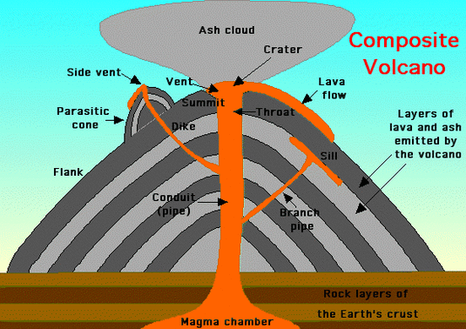
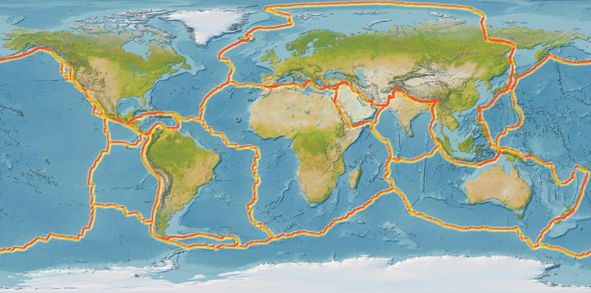
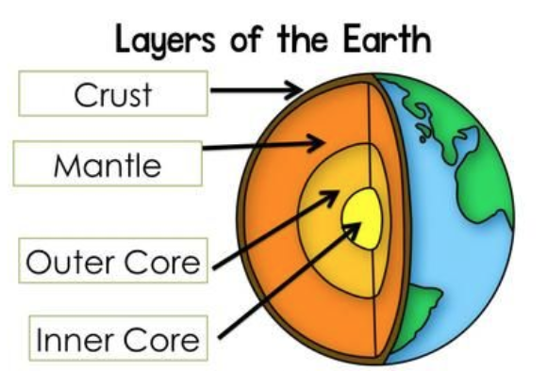

Slide 18
Block 6
Waterways of the UK

Slide 19


Summer
What are the major waterways close to Peterborough?
Key Concept: Settlements and Movement
Notes:
Settlements help us understand how people live in different parts of the world. (population, rural areas, urban areas)
Movement is all about how things move from one place to another. It can be the movement of people, animals, goods, or even ideas! (migration, navigation, transport)
Settlements
They can be urban or rural, big or small, with lots or just a few people living in them.
Settlements have different features that make them unique. Some features are buildings like houses, schools, hospitals, and shops. Others are natural features like rivers, mountains, or beaches. Some even have special landmarks like big statues or famous buildings.
Movements
Understanding movement in geography helps us learn about how different things are connected in the world. It shows how people, animals, goods, and ideas can move from one place to another, connecting different parts of the world together.
1. Human Movement
Human movement is all about how people move from one place to another. People can move for different reasons, such as:
Migration: This is when people move from one country to another to live there permanently. For example, someone moving to the United Kingdom from another country is migrating.
Traveling: People may also move temporarily to visit other places or go on holiday. This is called traveling. When you go on a family holiday to the beach, you are traveling.
2. Animal Movement
Just like humans, animals also move from one place to another for various reasons. Some examples of animal movement are:
Migration: Animals like birds and butterflies migrate to find better weather conditions or to find food. They travel long distances during migration.
Hunting: Predators like lions and tigers move around in search of food. They need to find their next meal, so they have to be on the move.
3. Goods Movement
Goods movement is all about the transportation of things that are made or grown in one place to another place.
E.g. Ships: Large cargo ships carry goods like cars, food, and clothes between different countries. These ships move the goods across the ocean.
4. Idea Movement
Ideas can also move from one place to another, thanks to technology and communication.
E.g. Internet: With the help of the internet, people can share information, knowledge, and ideas instantly across the world. It is like having a virtual movement of ideas!

Slide 20
Year 4 Block 6 Waterways of the UK | Retrieval vocab: agriculture, body of water, boiling, cliff, climate change, coast, coastline, condensation, erosion, evaporation, farming, lake, melting, ocean, precipitation, river, sea, species, stream, sublimation, tide, transpiration, tributary, wave, world heritage site New vocab: canal, deposition, downstream, industry, irrigation, mouth, national park, sediment, storm, drought Key concepts: boundaries (localities, nations); change (sustainability); climate (climate change, weather); interdependence (economy, trade); movement (transport); physical geography (bodies of water, topography); settlements (population, rural areas)
Week 1 (retrieval from science curriculum) | Know that geography is the study of places and the relationships between people and their environments Know that when liquids turn into gases, this is called evaporation and that the reverse process is called condensation (see diagram below) Know that when a solid turns into a gas without passing through the liquid state, this is called sublimation Know that the melting point of water is 0º C and that the boiling point of water is 100º C Know that water flows around our world in a continuous process called the water cycle (see diagram below) Know that, along with evaporation, water on the Earth’s surface moves to the air in a process called transpiration in which water turns into water vapour (gas) on the surface of leaves on plants Know that rain condenses in clouds and falls to earth as rain, snow or hail in a process called precipitation Know that water flows across the land in rivers and streams in a process called surface run-off and under the ground as groundwater
Week 2 (retrieval) | Know that where the land meets the sea is called a coast and when seen on a map this can be called a coastline; know that at the coast there can be steep drops where cliffs meet the sea or ocean and that there can be beaches where the land meets the sea or ocean Know that there are sandy beaches and pebble beaches, which depends on the strength of the waves in an area Know that the sand and pebbles on a beach have been created by the water hitting land and eroding it Know that the sea moves in waves and that tides bring the sea further into land, reaching a peak at high tide; and that at low tide sea is furthest from a particular part of the cost Begin to understand that the tides are caused by the orbit of the Moon around the Earth which pulls the sea via a force called gravity Know that the closest sea to Peterborough is the North Sea Know that there is one global ocean that is often divided into five distinct oceans and locate them on a world map and globe: the Pacific Ocean, the Atlantic Ocean, the Indian Ocean, the Southern Ocean and the Arctic Ocean Know that the Pacific Ocean is the largest body of water on Earth Know that seas are smaller bodies of water than oceans that are often partly surrounded by land and that other bodies of water include rivers and lakes Know that the UK is surrounded by: The North Sea, The English Channel, The Irish Sea and The Atlantic Ocean. Know that a tributary is a smaller river or stream that join a larger river, adding to its flow Know how to locate these bodies of water on a labelled map.
Notes:
Suggested number of sessions on each point to be added

Slide 21
Week 3 | Know that 2/3 of the Earth’s surface is covered by water, mostly oceans. Know that the UK is bordered by four seas: to the south by the English Channel, which separates it from continental Europe; to the east by the North Sea; and to the west by the Irish Sea and the Atlantic Ocean Know that Britain’s coastline – like that or every country – is changing due to erosion and deposition; know that erosion is where the movement of water, especially coastal waves, leads to the breaking down of cliffs into smaller pieces of rock; know that pebbles and sand are the result of erosion; know that deposition is where sediment that is carried by a river is dropped as the river slows at the river’s mouth
Week 4 | Know that rivers move downhill due to the force of gravity and towards seas and oceans, and that the location where a river meets the sea or ocean is called the mouth of a river Know that a location on a river that is further away from the sea or ocean is called upstream and that a location that is closer to the sea or oceans is called downstream Know that settlements, such as cities, towns and villages, have often been built alongside rivers because of the transportation links that rivers historically provided, as well as opportunities for irrigation Know that the earliest civilisations, including ancient Sumer, were formed on the floodplains beside rivers because settled people needed a supply of water and good soil for growing crops (retrieval from history) Know how to identify the River Severn, River Thames, River Trent, River Great Ouse and River Nene on a map of the UK; know that the River Nene runs through Peterborough and that the River Thames runs through London
Week 5 | Know that canals are artificial rivers created by humans for the purposes of transportation or irrigation; know that canals were important in Britain’s development and that many still exist across the UK Enquiry question: What are the major waterways close to Peterborough?
Week 6 | Know that the Lake District is one of the UK’s national parks and that it is also a designated world heritage site meaning that people have decided that it is very important and needs protection Know that England’s highest mountain, Scafell Pike (978 m) Know that until 200 years ago, the Lake District was a place mainly used for farming (agriculture) and industry, but that people recognised its beauty and people started visiting as tourists Know that the millions of people visit the Lake District each year; know that the increase in tourism continues to change the area, bringing benefits (tourism jobs, betters transport for everyone in the area) and challenges (footpath erosion, litter, lake pollution, traffic congestion) Know that climate change is causing extreme weather events that are affecting the Lake District, including threats to some species of animals and damage to woodland due to storm damage and drought
Field work: Visit some of the water ways in Peterborough looking at how the water flows and the tributaries.
Visiting the beach to look at the rock formation and it’s settlement from the tides, the erosion and deposition of rocks.

Slide 22
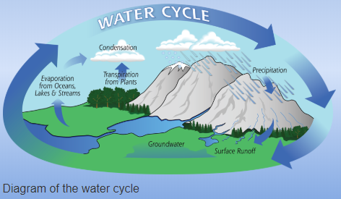
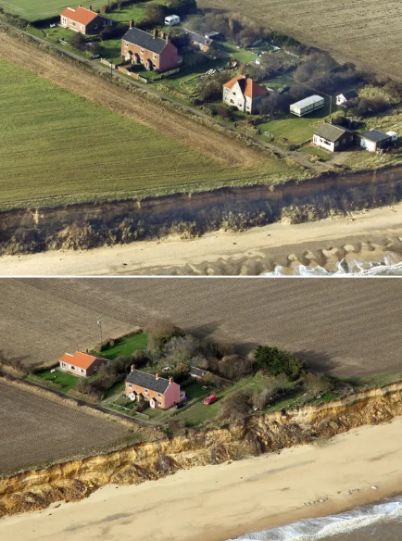
Example of coastal erosion in Suffolk over 20 years

